Slide 1
Overview
Dutch Azure Meetup

Slide 2
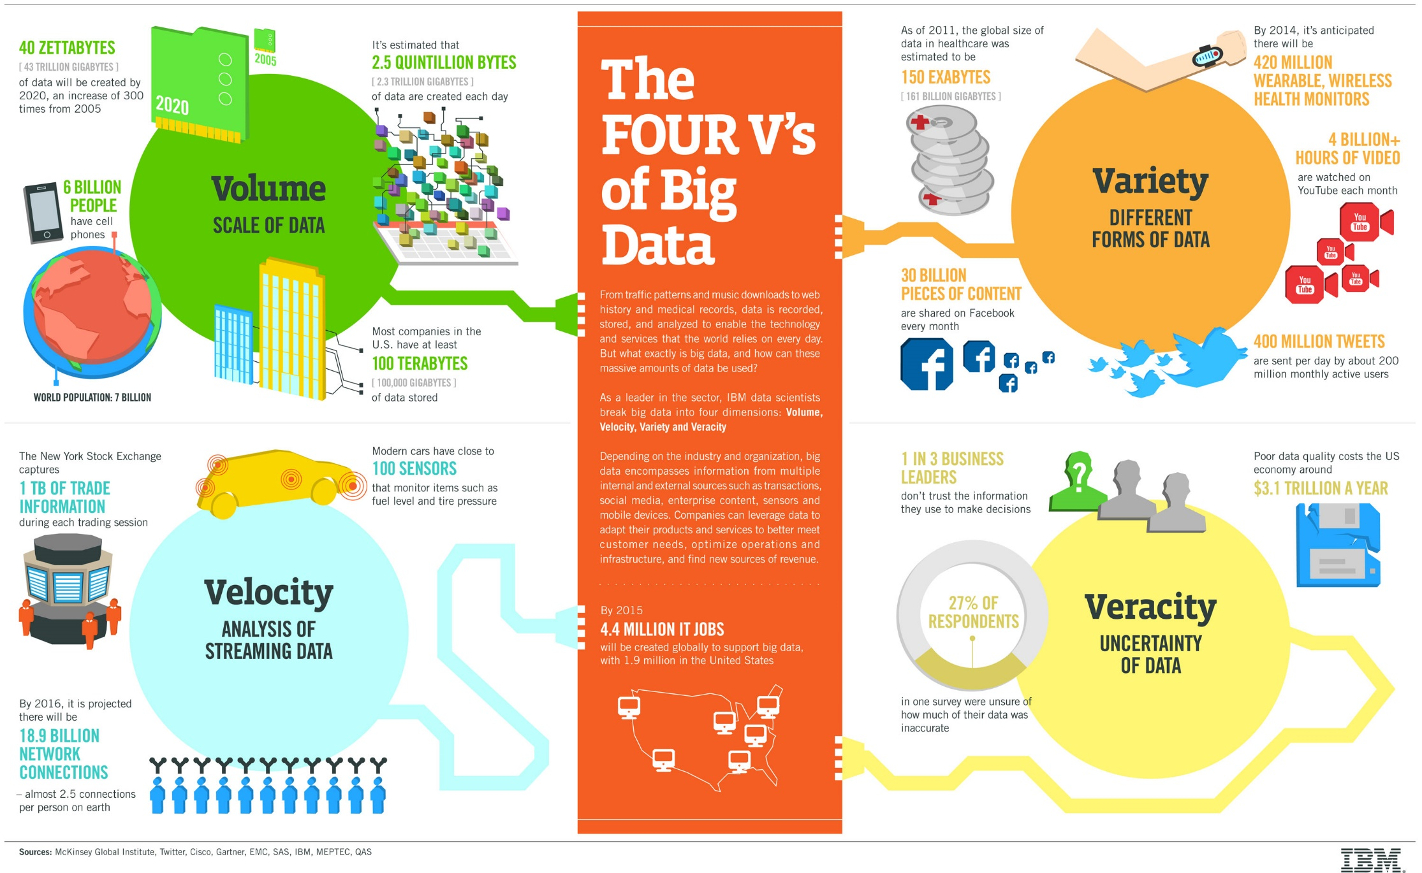
Big Data
The 4 V’s

Slide 3
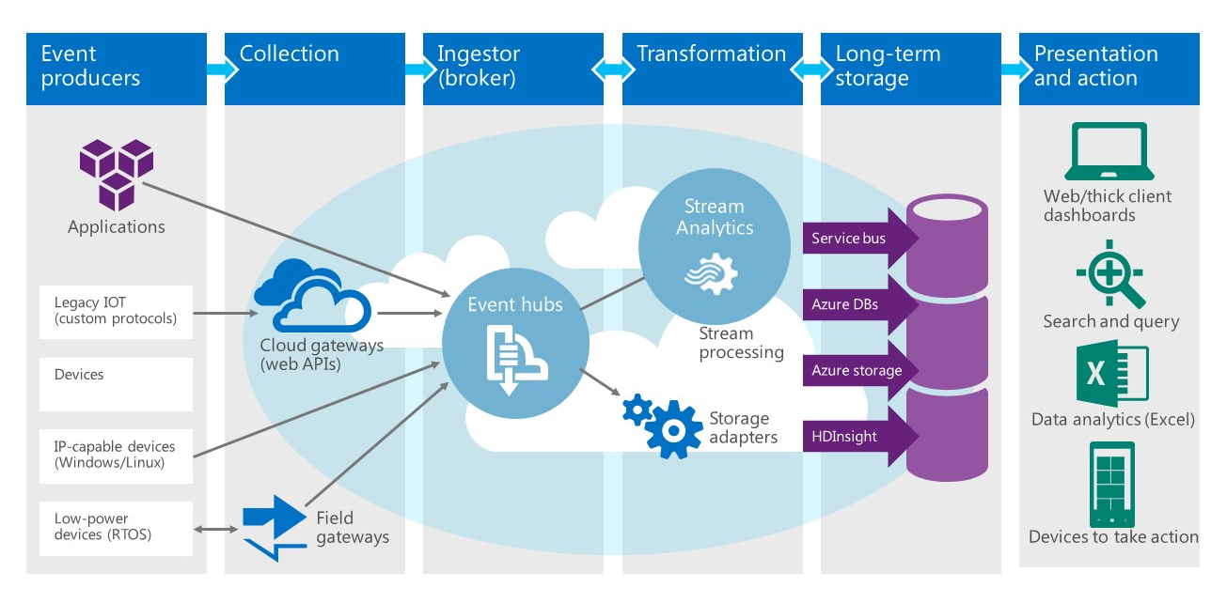

Slide 4
Hands-on Architecture

